Slide 1
Homeostasis
Regulation of blood sugar

Slide 2
The Liver
Converts glucose into glycogen to store excess glucose (glycogenesis) – will do this when the blood sugar level is high.
Convert glycogen into glucose for release into the blood (glycogenolysis) – will do this when the blood sugar level is low.
The livers blood supply comes from the hepatic portal vein (blood leaving the stomach and the rest of the digestive system)

Slide 3
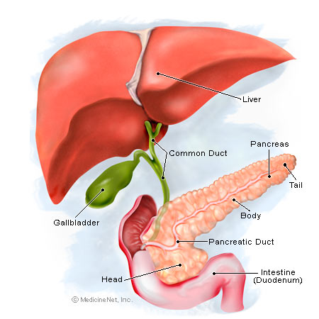
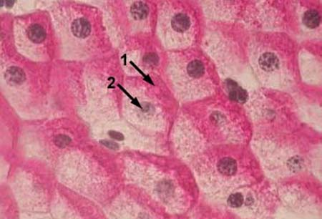
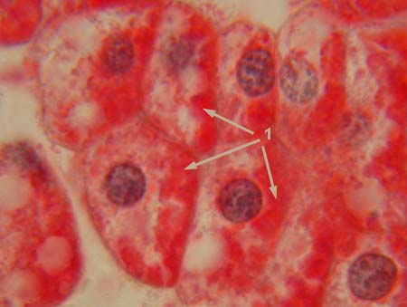
1 - glycogen (red or magenta staining)
2 - nuclei

Slide 4
Pancreas
Contains hormone secreting cells called the islets of Langerhans.
Alpha cells release glucagon which stimulates glycogenolysis (more glucose in the blood)
Beta cells secrete insulin which stimulates glycogenesis (less glucose in the blood)

Slide 5
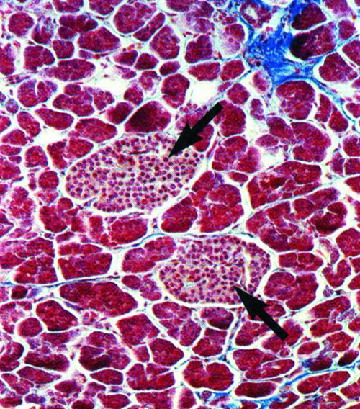
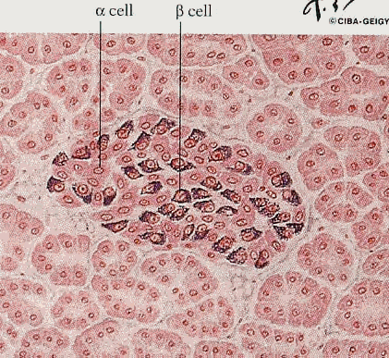

Slide 6
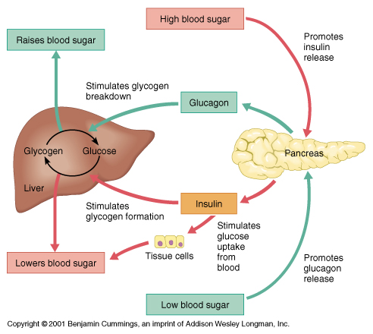

Slide 7
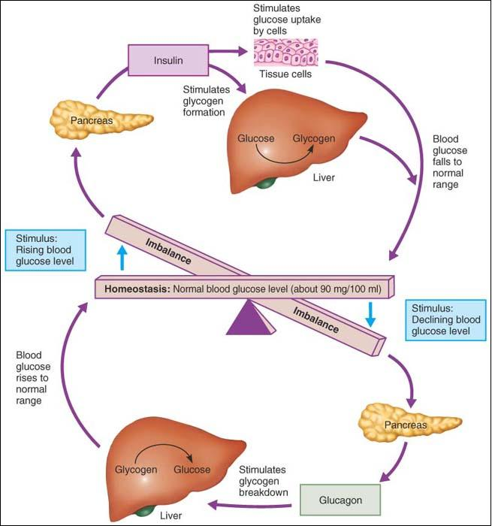

Slide 8
Negative feedback loop – low blood sugar levels
Decreased blood glucose
(sugar) levels
glucoreceptors in the alpha cells of pancreas
Stimulus
Receptor
Blood glucose (sugar) levels increase
Alpha cells secrete glucagon
Control
centre
Feedback
Glucose released into blood
Glucagon travels in blood to liver
Response
Effector
Glycogen in liver and skeletal muscle converted into glucose (glycogenolysis)
Gluconeogenesis can occur turning amino acids into glucose. Lipolysis can occur turning fatty acids into glucose
Liver and skeletal muscle

Slide 9
Negative feedback loop – high blood sugar levels
Increased blood glucose
(sugar) levels
glucoreceptors inbeta cells pancreas
Stimulus
Receptor
Blood glucose (sugar) levels decrease
Beta cells secrete insulin
Control
centre
Feedback
Glucose taken up and used by cells and stored by liver as glycogen
Insulin travels in blood to liver and all body cells
Response
Effector
Glycogenesis – conversion of glucose into glycogen
Promotes up take of glucose and protein synthesis
Liver
All cells

Slide 10
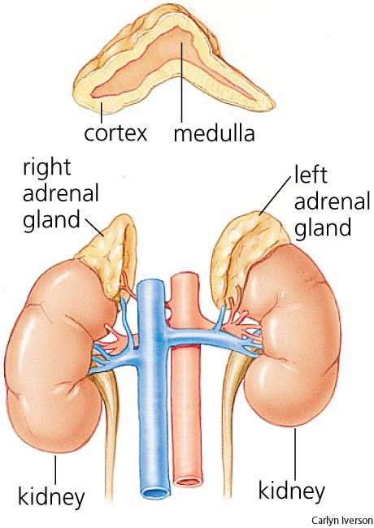
Adrenal Glands
These form the second tier of influence on blood glucose levels
Situated just above the kidney.
Composed of the cortex and medulla
Secrete a wide variety of hormones and have a wide variety of roles in the human body

Slide 11
Adrenal Cortex
Stimulated by adrenocorticotrophic hormone (ACTH) – released from the anterior lobe of the pituitary
Secretes glucocorticoids most common example is cortisol.
Increase carbohydrate metabolism by
  Increasing the rate of glycogenolysis (break down of glycogen to glucose) and
  Gluconeogenesis (conversion of fats and amino acids to form glucose) – usually taken from muscle cells.

Slide 12
Adrenal medulla
Synthesises adrenaline and noradrenaline
Associated with the sympathetic response (preparing the body for activity)
One of a number of effects is to cause an elevation in blood sugar levels by stimulating glycogenolysis.

